Slide 1
TNA Steering Committee Meeting December 2015 Human Resources
Joline Manning

Slide 2
Headcount – December 1, 2015-TNA
Functional Department | CO-Solon | Waterloo | Farnham | MF | MF DC | CF | Florence West | Florence East | DW | CO-Dalton | Canada | Tufting | Yarn & Dye | Service Ctr | Finishing | Enviro Ctr | Extrusion | Field | Total
 |  |  |  | Plant
Operations
Operations | 1 | 43 | 113 | 114 |  | 188 | 332 | 70 | 1 |  | 200 | 208 | 146 | 9 | 118 | 51 | 71 |  | 1665
Supply Chain | 15 | 4 | 36 | 2 | 67 | 14 | 25 | 15 | 24 |  | 8 |  | 3 | 30 | 2 |  | 2 |  | 247
Maintenance | 0 | 4 | 24 | 9 |  | 13 | 25 |  |  |  | 17 | 14 | 12 | 1 | 14 | 4 | 14 |  | 151
Quality | 1 | 1 | 2 | 1 |  | 3 | 17 |  |  |  | 9 | 1 | 5 |  | 5 |  | 1 |  | 46
Engineering | 0 | 3 | 2 | 3 |  | 3 | 6 | 1 |  |  | 7 | 2 | 2 |  | 3 | 4 |  |  | 36
EHS | 0 | 1 | 1 | 1 |  | 1 | 2 | 1 |  | 3 | 1 |  |  |  |  | 2 |  |  | 13
WCM | 1 | 1 |  | 1 |  |  | 1 | 1 |  | 2 |  |  |  |  |  | 2 |  |  | 9
Sales |  |  |  |  |  |  |  |  |  |  |  |  |  |  |  |  |  |  | 0
Commercial | 36 | 1 |  |  |  |  |  |  | 6 |  |  |  |  |  |  |  |  | 154 | 197
Market Devlp | 17 | 1 |  |  |  |  |  |  |  |  |  |  |  |  |  |  |  | 10 | 28
Residential | 20 |  | 11 |  |  |  |  |  | 18 |  |  |  |  |  |  |  |  |  | 49
Customer Svc | 37 |  | 6 |  |  |  |  | 10 | 11 |  | 1 |  |  | 62 |  |  |  |  | 127
Administrative |  |  |  |  |  |  |  |  |  |  |  |  |  |  |  |  |  |  | 0
Administrative | 4 | 1 | 0 |  |  |  | 1 | 1 | 1 | 6 | 4 |  | 3 | 19 | 1 | 3 |  | 13 | 57
Finance | 28 | 3 | 7 | 1 |  | 3 | 6 | 6 | 6 |  | 3 |  |  | 36 |  |  | 1 |  | 100
Human Resources | 11 | 1 | 3 | 1 | 2 | 2 | 4 | 1 |  | 9 | 3 |  |  |  |  |  | 1 |  | 38
IT | 16 |  | 1 |  |  |  | 1 |  |  |  | 4 |  |  | 24 |  |  |  |  | 46
Legal | 3 |  | 2 |  |  |  |  |  |  |  |  |  |  |  |  |  |  |  | 5
Marketing | 18 |  | 6 | 0 | 15 |  | 2 | 5 |  | 13 |  |  |  |  |  |  |  |  | 59
Technical Services | 10 |  | 2 | 0 | 4 |  |  |  |  |  |  |  |  | 9 |  |  |  |  | 25
R&D | 0 |  | 7 | 10 |  | 2 | 3 | 1 |  |  |  |  |  |  | 14 |  |  |  | 37
Sustainability | 2 |  |  |  |  |  |  |  |  |  |  |  |  |  |  |  |  |  | 2
Design | 5 |  | 6 |  |  |  |  |  |  |  | 16 |  | 16 |  |  |  |  | 2 | 45
Executive | 4 | 1 |  |  |  |  |  |  |  | 9 |  |  |  |  |  | 1 |  | 1 | 16
Functional Total | 229 | 65 | 229 | 143 | 88 | 229 | 425 | 112 | 67 | 42 | 273 | 225 | 187 | 190 | 157 | 67 | 90 | 180 | 2998
Temporary Ees | 5 | 4 | 4 | 6 | 22 | 6 | 18 | 20 | 5 | 0 | 0 | 10 | 18 | 5 | 0 | 0 | 0 | 0 | 123
December 1st Grand Total | 234 | 69 | 233 | 149 | 110 | 235 | 443 | 132 | 72 | 42 | 273 | 235 | 205 | 195 | 157 | 67 | 90 | 180 | 3121
November 1st Grand Total | 234 | 71 | 233 | 149 | 110 | 235 | 443 | 132 | 72 | 42 | 270 | 239 | 208 | 199 | 162 | 67 | 91 | 181 | 3138
MOM Variance | 0 | -2 | 0 | 0 | 0 | 0 | 0 | 0 | 0 | 0 | 3 | -4 | -3 | -4 | -5 | 0 | -1 | -1 | -17

Slide 3
Diversity Dashboard – Race TNA Consolidated

Slide 4
Diversity Dashboard - Gender
TNA Consolidated
Resilient
Soft Surface

Slide 5
Tarkett North America Turnover Summary
TNA Consolidated
2015 Turnover | # of Losses | Month | YTD | Annualized
TNA Consolidated | 458 YTD | 0.93% | 15.4% | 16.8%
Involuntary
Salaried | 3 | 0.1% | 1.6% | 1.7%
Hourly | 13 | 0.4% | 4.9% | 5.3%
Voluntary
Salaried | 4 | 0.1% | 3.4% | 3.8%
Hourly | 8 | 0.3% | 5.6% | 6.1%
Resilient
Soft Surface
2015 Turnover | # of Losses | Month | YTD | Annualized
TNA RES | 230 YTD | 0.88% | 14.6% | 15.9%
Involuntary
Salaried | 3 | 0.2% | 2.4% | 2.6%
Hourly | 6 | 0.4% | 5.3% | 5.7%
Voluntary
Salaried | 3 | 0.2% | 3.8% | 4.1%
Hourly | 2 | 0.1% | 3.1% | 3.4%
2015 Turnover | # of Losses | Month | YTD | Annualized
TC Consolodated | 228 YTD | 1.00% | 16.4% | 17.9%
Involuntary
Salaried | 0 | 0.0% | 0.6% | 0.6%
Hourly | 7 | 0.5% | 4.5% | 4.9%
Voluntary
Salaried | 1 | 0.1% | 3.0% | 3.3%
Hourly | 6 | 0.4% | 8.4% | 9.1%

Slide 6
Turnover By Location-Resilient
2015 Turnover | # of Losses | Month | YTD | Annualized |  | 2015 Turnover | # of Losses | Month | YTD | Annualized |  | 2015 Turnover | # of Losses | Month | YTD | Annualized
Corporate | 36 | 1.75% | 16.1% | 17.5% |  | Middlefield | 12 | 0.0% | 8.2% | 8.9% |  | Middlefield DC | 5 | 0.0% | 5.7% | 6.3%
Involuntary |  |  |  |  |  | Involuntary |  |  |  |  |  | Involuntary
Salaried | 1 | 0.4% | 4.5% | 4.9% |  | Salaried | 0 | 0% | 0% | 0% |  | Salaried | 0 | 0% | 0% | 0.0%
Hourly | 0 | 0% | 0% | 0% |  | Hourly | 0 | 0.0% | 4.1% | 4.5% |  | Hourly | 0 | 0.0% | 3.4% | 3.8%
Voluntary |  |  |  |  |  | Voluntary |  |  |  |  |  | Voluntary
Salaried | 3 | 1.3% | 11.6% | 12.7% |  | Salaried | 0 | 0.0% | 1.4% | 1% |  | Salaried | 0 | 0.0% | 2.3% | 2.5%
Hourly | 0 | 0% | 0% | 0% |  | Hourly | 0 | 0.0% | 2.7% | 3.0% |  | Hourly | 0 | 0% | 0% | 0%
2015 Turnover | # of Losses | Month | YTD | Annualized |  | 2015 Turnover | # of Losses | Month | YTD | Annualized |  | 2015 Turnover | # of Losses | Month | YTD | Annualized
Chagrin Falls | 19 | 0.4% | 8.7% | 9.5% |  | Waterloo | 10 | 1.4% | 14.4% | 15.7% |  | Florence West | 88 | 1.6% | 21.4% | 23.3%
Involuntary |  |  |  |  |  | Involuntary |  |  |  |  |  | Involuntary
Salaried | 0 | 0.0% | 1.4% | 1.5% |  | Salaried | 0 | 0% | 0.0% | 0.0% |  | Salaried | 2 | 0.5% | 2.4% | 2.7%
Hourly | 1 | 0.4% | 2.7% | 3.0% |  | Hourly | 0 | 0.0% | 7.2% | 7.9% |  | Hourly | 5 | 1.2% | 10.9% | 11.9%
Voluntary |  |  |  |  |  | Voluntary |  |  |  |  |  | Voluntary
Salaried | 0 | 0.0% | 1.4% | 1.5% |  | Salaried | 0 | 0% | 0% | 0% |  | Salaried | 0 | 0.0% | 1.7% | 1.9%
Hourly | 0 | 0.0% | 3.2% | 3.5% |  | Hourly | 1 | 1.4% | 7.2% | 7.9% |  | Hourly | 0 | 0.0% | 6.3% | 6.9%
2015 Turnover | # of Losses | Month | YTD | Annualized |  | 2015 Turnover | # of Losses | Month | YTD | Annualized |  | 2015 Turnover | # of Losses | Month | YTD | Annualized
Florence East | 18 | 0.0% | 16.8% | 18.4% |  | Farnham | 39 | 0.4% | 15.9% | 17.3% |  | Diamond W | 3 | 0.0% | 4.5% | 4.9%
Involuntary |  |  |  |  |  | Involuntary |  |  |  |  |  | Involuntary
Salaried | 0 | 0.0% | 1.9% | 2.0% |  | Salaried | 0 | 0.0% | 4.9% | 5.3% |  | Salaried | 0 | 0.0% | 1.5% | 1.6%
Hourly | 0 | 0.0% | 7.5% | 8.2% |  | Hourly | 0 | 0.0% | 4.1% | 4.4% |  | Hourly | 0 | 0% | 0% | 0%
Voluntary |  |  |  |  |  | Voluntary |  |  |  |  |  | Voluntary
Salaried | 0 | 0.0% | 3.7% | 4.1% |  | Salaried | 0 | 0.0% | 5.7% | 6.2% |  | Salaried | 0 | 0.0% | 3.0% | 3.3%
Hourly | 0 | 0.0% | 3.7% | 4.1% |  | Hourly | 1 | 0.4% | 1.2% | 1.3% |  | Hourly | 0 | 0% | 0% | 0%

Slide 7
Turnover By Location-Soft Surface
2015 Turnover | # of Losses | Month | YTD | Annualized |  | 2015 Turnover | # of Losses | Month | YTD | Annualized |  | 2015 Turnover | # of Losses | Month | YTD | Annualized |  | 2015 Turnover | # of Losses | Month | YTD | Annualized
TC Consolodated | 228 YTD | 1.00% | 16.4% | 17.9% |  | Dalton | 190 YTD | 1.2% | 17.1% | 18.7% |  | Canada | 38 YTD | 0.3% | 13.7% | 14.9% |  | Corporate | 8 YTD | 0.00% | 19.0% | 20.7%
Involuntary |  |  |  |  |  | Involuntary |  |  |  |  |  | Involuntary |  |  |  |  |  | Involuntary
Salaried | 0 | 0.0% | 0.6% | 0.6% |  | Salaried | 0 | 0.0% | 0.8% | 0.9% |  | Salaried | 0 | 0% | 0% | 0.0% |  | Salaried | 0 | 0.0% | 4.8% | 5.2%
Hourly | 7 | 0.5% | 4.5% | 4.9% |  | Hourly | 7 | 0.6% | 4.7% | 5.1% |  | Hourly | 0 | 0.0% | 3.6% | 3.9% |  | Hourly | 0 | 0.0% | 0.0% | 0.0%
Voluntary |  |  |  |  |  | Voluntary |  |  |  |  |  | Voluntary |  |  |  |  |  | Voluntary
Salaried | 1 | 0.1% | 3.0% | 3.3% |  | Salaried | 0 | 0.0% | 3.1% | 3.3% |  | Salaried | 1 | 0.3% | 2.2% | 2.4% |  | Salaried | 0 | 0.0% | 14.3% | 15.6%
Hourly | 6 | 0.4% | 8.4% | 9.1% |  | Hourly | 6 | 0.5% | 8.5% | 9.2% |  | Hourly | 0 | 0.0% | 7.9% | 8.6% |  | Hourly | 0 | 0.0% | 0.0% | 0.0%
2015 Turnover | # of Losses | Month | YTD | Annualized |  | 2015 Turnover | # of Losses | Month | YTD | Annualized |  | 2015 Turnover | # of Losses | Month | YTD | Annualized |  | 2015 Turnover | # of Losses | Month | YTD | Annualized
Tufting | 50 YTD | 0.9% | 22.4% | 24.5% |  | Yarn & Dye | 29 YTD | 1.1% | 15.9% | 17.3% |  | Service Ctr | 16 YTD | 0.0% | 8.8% | 9.6% |  | Finishing | 43 YTD | 4.5% | 27.2% | 29.6%
Involuntary |  |  |  |  |  | Involuntary |  |  |  |  |  | Involuntary |  |  |  |  |  | Involuntary
Salaried | 0 | 0% | 0.4% | 0.5% |  | Salaried | 0 | 0% | 0.5% | 0.6% |  | Salaried | 0 | 0.0% | 0.6% | 0.6% |  | Salaried | 0 | 0.0% | 0.0% | 0.0%
Hourly | 1 | 0.4% | 7.2% | 7.8% |  | Hourly | 1 | 0.5% | 3.3% | 3.6% |  | Hourly | 0 | 0.0% | 0.6% | 0.6% |  | Hourly | 5 | 3.2% | 9.5% | 10.3%
Voluntary |  |  |  |  |  | Voluntary |  |  |  |  |  | Voluntary |  |  |  |  |  | Voluntary
Salaried | 0 | 0.0% | 0.4% | 0.5% |  | Salaried | 0 | 0.0% | 1.1% | 1.2% |  | Salaried | 0 | 0.0% | 6.1% | 6.6% |  | Salaried | 0 | 0.0% | 0.6% | 0.7%
Hourly | 1 | 0.4% | 14.4% | 15.7% |  | Hourly | 1 | 0.5% | 10.9% | 11.9% |  | Hourly | 0 | 0.0% | 1.7% | 1.8% |  | Hourly | 2 | 1.3% | 17.1% | 18.6%
2015 Turnover | # of Losses | Month | YTD | Annualized |  | 2015 Turnover | # of Losses | Month | YTD | Annualized |  | 2015 Turnover | # of Losses | Month | YTD | Annualized
Enviro Ctr | 16 YTD | 1.5% | 25.5% | 27.8% |  | Extrusion | 11 YTD | 1.1% | 12.1% | 13.2% |  | Field Sales | 11 YTD | 0.0% | 7.5% | 8.1%
Involuntary |  |  |  |  |  | Involuntary |  |  |  |  |  | Involuntary
Salaried | 0 | 0.0% | 0.0% | 0.0% |  | Salaried | 0 | 0.0% | 0.0% | 0.0% |  | Salaried | 0 | 0.0% | 2.0% | 2.2%
Hourly | 0 | 0.0% | 14.3% | 15.7% |  | Hourly | 0 | 0.0% | 3.3% | 3.6% |  | Hourly | 0 | 0% | 0% | 0%
Voluntary |  |  |  |  |  | Voluntary |  |  |  |  |  | Voluntary
Salaried | 0 | 0% | 0.0% | 0.0% |  | Salaried | 0 | 0.0% | 1.1% | 1.2% |  | Salaried | 0 | 0.0% | 5.4% | 5.9%
Hourly | 1 | 1.5% | 11.2% | 12.2% |  | Hourly | 1 | 1.1% | 7.7% | 8.4% |  | Hourly | 0 | 0% | 0% | 0%

Slide 8
TNA Recruiting Metrics Salaried Filled Position – 12/1/15
Row Labels | Average Days to Fill (accepted offer) | # of hires
Commercial Sales | 88 | 16
Customer Support | 53 | 5
Corp | 56 | 1
Design | 78 | 1
EHS | 16 | 2
Engineering | 92 | 5
Finance | 81 | 6
HR | 89 | 5
IT | 82 | 2
Marketing | 101 | 10
Market Development | 165 | 3
Operations | 80 | 25
Quality | 124 | 2
R & I | 87 | 4
Residential Sales | 90 | 4
Supply Chain | 105 | 14
Technology | 198 | 2
WCM | 107 | 3
Grand Total | 91 | 110
2015 Hires by Source | Cost to Fill | Number of Filled
External | $ 1,462,326 | 38
Internal | $ 3,485 | 72
Fixed | $ 36,483
Grand Total | $ 1,502,294 | 110

Slide 9
TNA Filled jobs by source – 12/1/2015

Slide 10
TNA Recruiting Metrics Salaried Open Position – 12/1/15
Function | # of Days Open | # of Open Roles
Commercial Sales | 42 | 5
Design | 35 | 1
Engineering | 46 | 2
Finance | 51 | 3
HR | 63 | 2
Maintenance | 14 | 1
Marketing | 141 | 5
Operations | 86 | 9
Quality | 176 | 1
Residential Sales | 86 | 3
Supply Chain | 76 | 5
R & I | 4 | 1
Customer Support | 24 | 3
Market Development | 473 | 3
Grand Total | 100 | 44
Location | Function | New/ Backfill | Job Title – Open over 100 days
Remote (TX) | Commercial Sales | Backfill | Regional Business Manager, 154 days
Dalton | Operations | Backfill | Yarn Supervisor, 145 days
Dalton | Marketing | Backfill | Graphic Designer, 141 days
Dalton | Marketing | New | Marketing Project Mgr, 175 days

Slide 11
BACK-UP

Slide 12
Diversity Dashboard – Race-Resilient

Slide 13
Diversity Dashboard – Race—Soft Surface

Slide 14
Soft Surface Recruiting Metrics Salaried Filled Position – 12/1/2015
Function | Average # of Days to Fill
Commercial Sales | 53
Customer Support | 34
EHS | 11
Engineering | 30
Finance | 72
HR | 61
IT | 146
Operations | 93
Marketing | 79
WCM | 59
Grand Total | 66
2015 Hires by Source | Cost to Fill | Number of Filled
External | $ 272,040 | 9
Internal | $ 8,771 | 26
Fixed | $ 15,083 | 0
Total | $ 295,894 | 35

Slide 15
Soft Surface Recruiting Metrics Salaried Open Position – 12/1/2015
Function | # of Open Roles | Average # of Days Open
Engineering | 1 | 77
Finance | 1 | 101
Commercial Sales | 4 | 22
Marketing | 4 | 55
Customer Support | 2 | 60
Total Average | 12 | 50
Location | Function | New/ Backfill | Job Title – Director & Above
Location | Function | New/ Backfill | Job Title – Open over 100 days
Dalton | Finance | Backfill | Cost Accountant
Dalton | Marketing | New | Marketing Project Manager: Hospitality

Slide 16
Resilient Recruiting Metrics Salaried Filled Position – 12/7/15
Row Labels | Average of # of Days to Accepted Offer (fill)
Commercial Sales | 154
Corp | 56
Design | 78
Engineering | 114
Human Resources | 85
IT | 18
Marketing | 110
Operations | 58
Residential Sales | 110
Market Development | 165
Supply Chain | 113
R & I | 124
WCM | 204
Quality | 73
Grand Total | 104
2015 Hires by Source | Cost to Fill | Number of Filled
External | $ 1,222,696 | 31
Internal | $ 3,485 | 48
Fixed | $ 21,400
Grand Total | $ 1,247,581 | 79

Slide 17
Resilient Recruiting Metrics Salaried Open Position – 12/1/15
Function | Average # of Days Open | # of Open Roles
Commercial Sales | 151 | 1
Operations | 121 | 7
Residential Sales | 88 | 4
Market Development | 504 | 3
Supply Chain | 107 | 7
Human Resources | 93 | 1
Technology | 35 | 1
HR | 94 | 1
Maintenance | 45 | 1
Design | 63 | 1
Engineering | 108 | 1
Marketing |  | 1
Grand Total | 150 | 29
Location | Function | New/ Backfill | Job Title – Director & Above
Location | Function | New/ Backfill | Job Title – Open over 100 days
Remote (TX) | Commercial Sales | Backfill | Regional Business Manager, 154 days

Slide 18
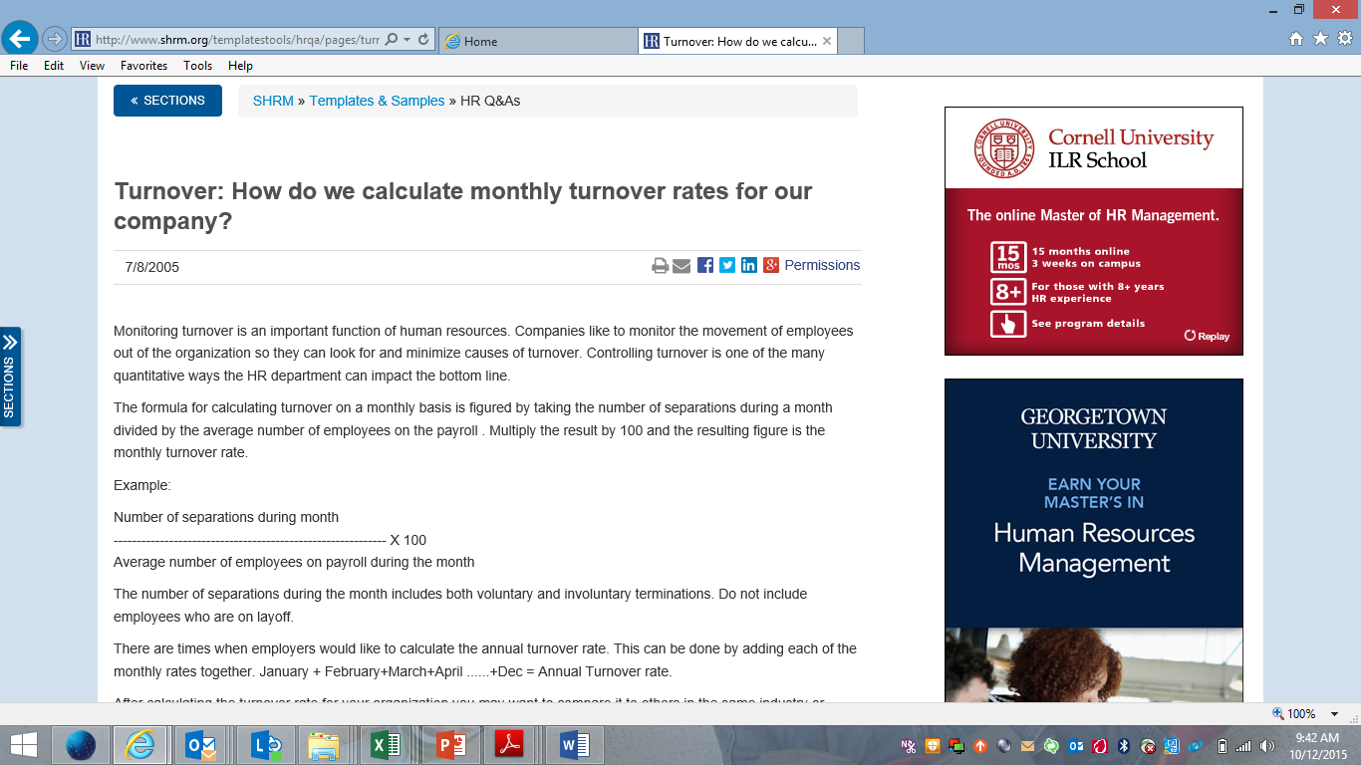
Turnover Calculation
YTD TNA Turnover is calculated by dividing total terminations by average number of associates on payroll during that month
Annualized TNA Turnover is calculated by dividing total terminations by average number of associates on payroll during that month * 12 divided by total data collection months

Slide 19
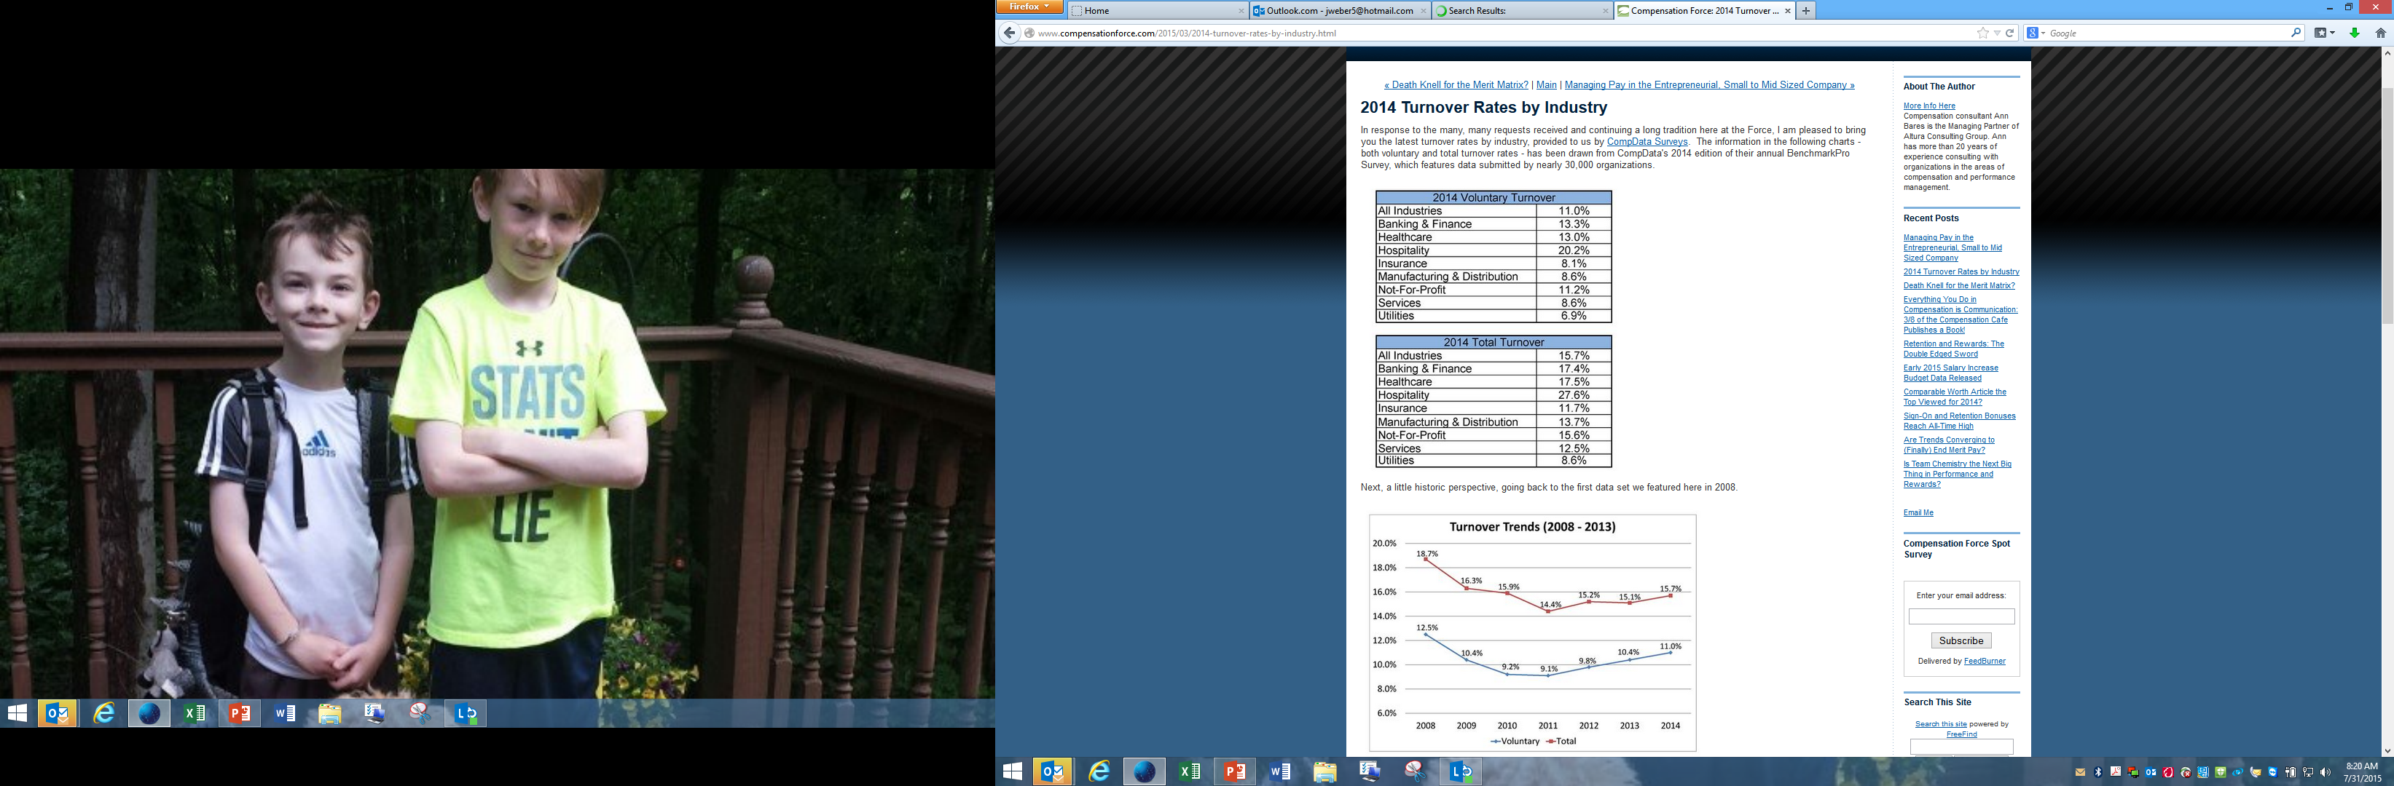
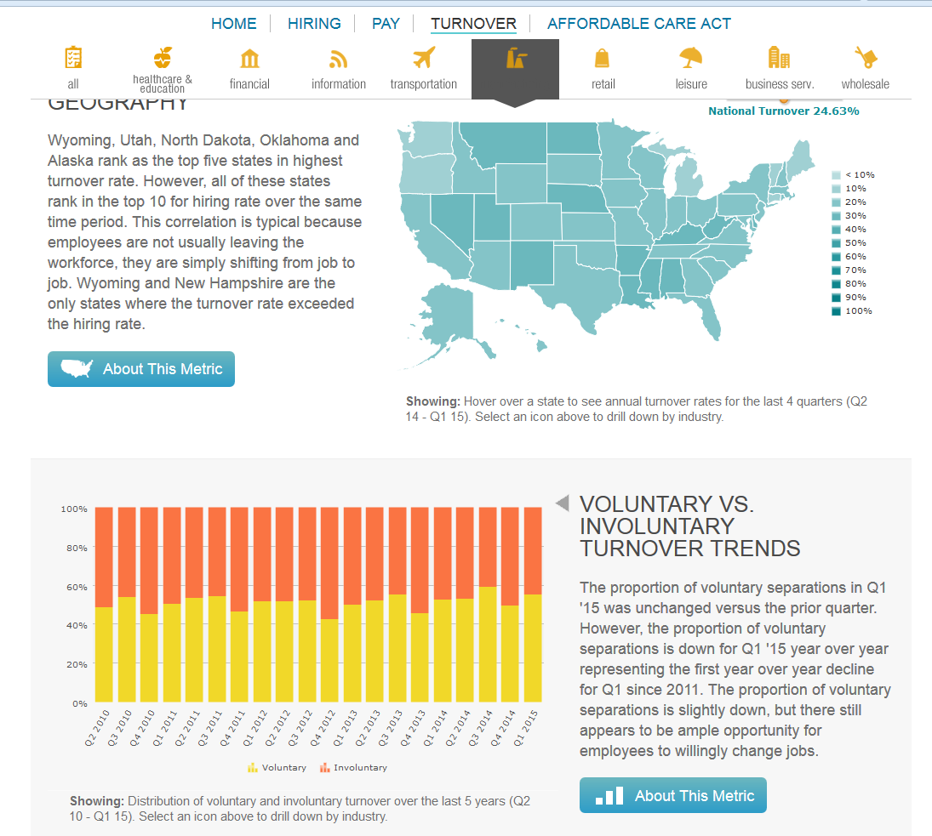
Turnover Benchmark Data
National Turnover 24.63%
Ohio 21.32%
Alabama 30.08%
Georgia 29.24%

